Slide 1


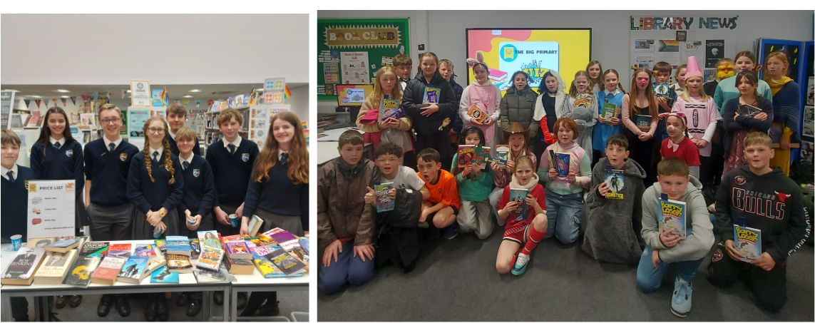


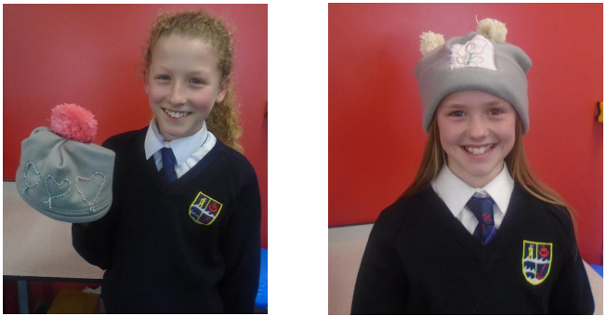

Parent & Carer News
LAST DAY OF TERM
Friday
04th April
This Week’s News
28th March 2025
World Book Day
Howmet Visit
Cameron Jones Visit
Fun with Fleece
Parent Support
Cross Country
Exmouth Eco’s
MHW Update
6th Form Elective
The Blend
Key Dates:
March
29th – TT Day Walk (full kit) E.Devon
April
Last Week: Celebration Assemblies
4th – Last day of Term
The Big Book Primary Quiz was held at ECC with 8 teams from 4 primary schools competing in the library to celebrate World Book Day. Students completed themed book rounds covering books from 7 different decades. St Joseph's School – Team Cruella’s Minions won, winning chocolate and a selection of books for school.
A super team of library monitors and Book Club members ran a Book and Cake Sale at break raising money for Book Aid International. It was very popular raising over £170!
KS3 Activity Week
Activity Week allocation letters were emailed to parents on 20th March. Please ensure you pay the £20 deposit for your child's activity by 31st March on iPay to secure their place. If you have any queries regarding Activity Week please email activitiesweek@exmouthcollege.devon.sch.uk
If you have any queries about paying please email ipay@exmouthcollege.devon.sch.uk
Financial Management Experience
Fiona Cameron, from Cameron Jones Financial Management, and apprentice Josie came into college to talk to over 100 students from yr7-13 interested in pursuing a career in financial management. Fiona gave tips on how to get into the role and also explained how varied her work is. Josie, an ex ECC student who left Y11 last July, is currently completing her apprenticeship with Cameron Jones and said that she has found it to be 'empowering to be working in an all-female team' and her confidence and skills have grown enormously.
Fun with Fleece
Textiles club, part of the College Enrichment programme, students have been making made-to-measure hats from fleece, personalising them with handmade pom-poms, applique and couching. Some have even used the computerised embroidery machine!
The club’s next project is aprons with a handmade print, pockets and applique decoration.
Why not come along Tues 3.15-4pm in 322
Support For Separating Parents in Devon.
The Devon-based Social Enterprise, Only Mums & Dads with the support of Devon County Council is offering free on-line support to parents going through a divorce or separation. Group webinars are held fortnightly and are completely free to attend. Any parent can also get the free Devon Separation Resource Pack. Further information can be found here
Free
Resource
Pack
Free Webinars

Slide 2
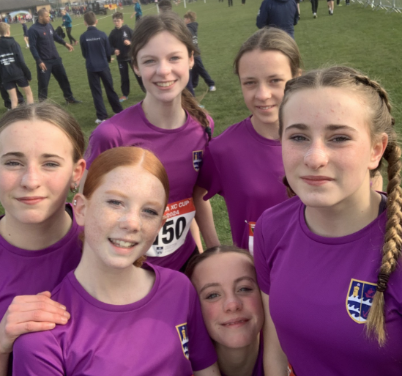

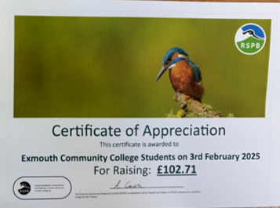
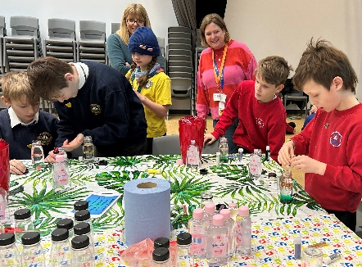

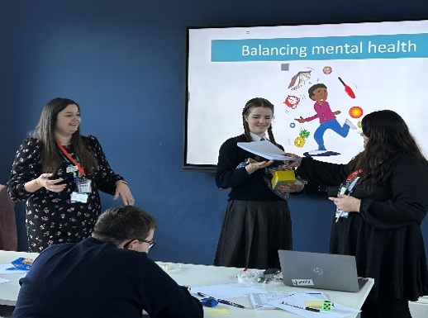
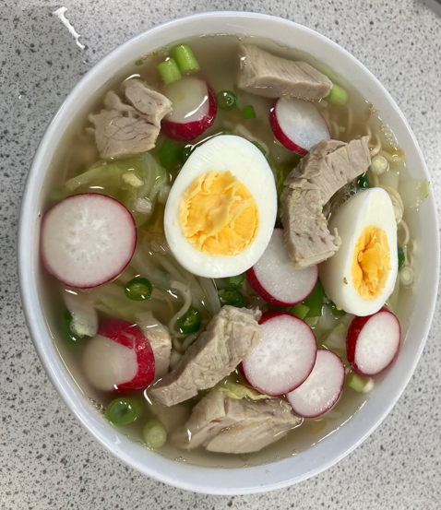
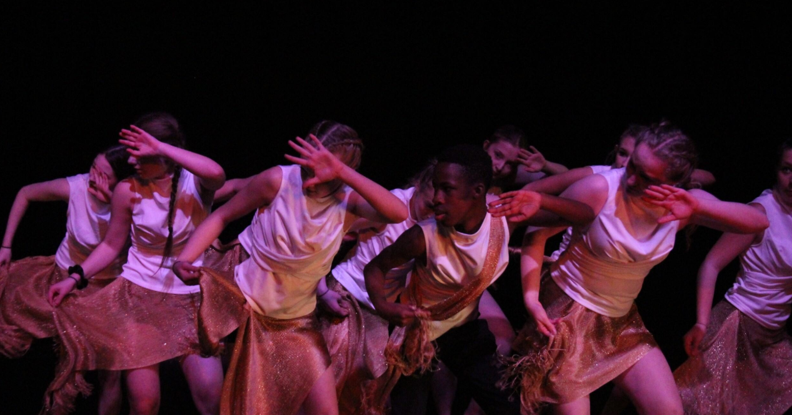
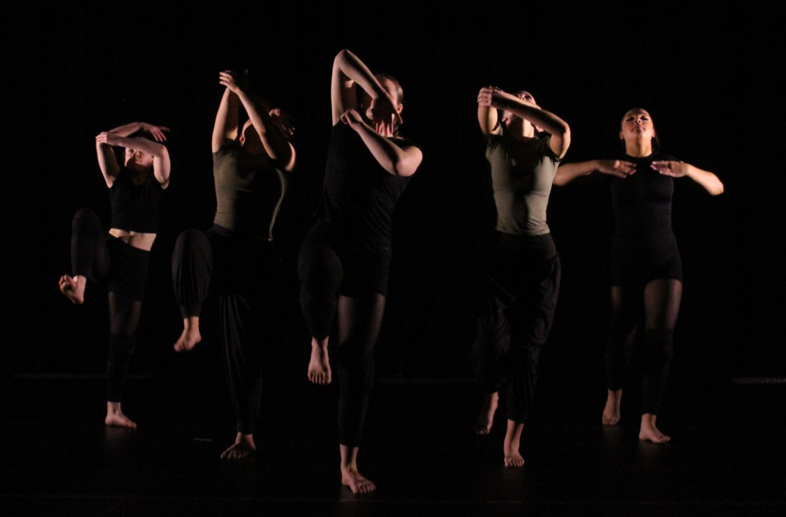
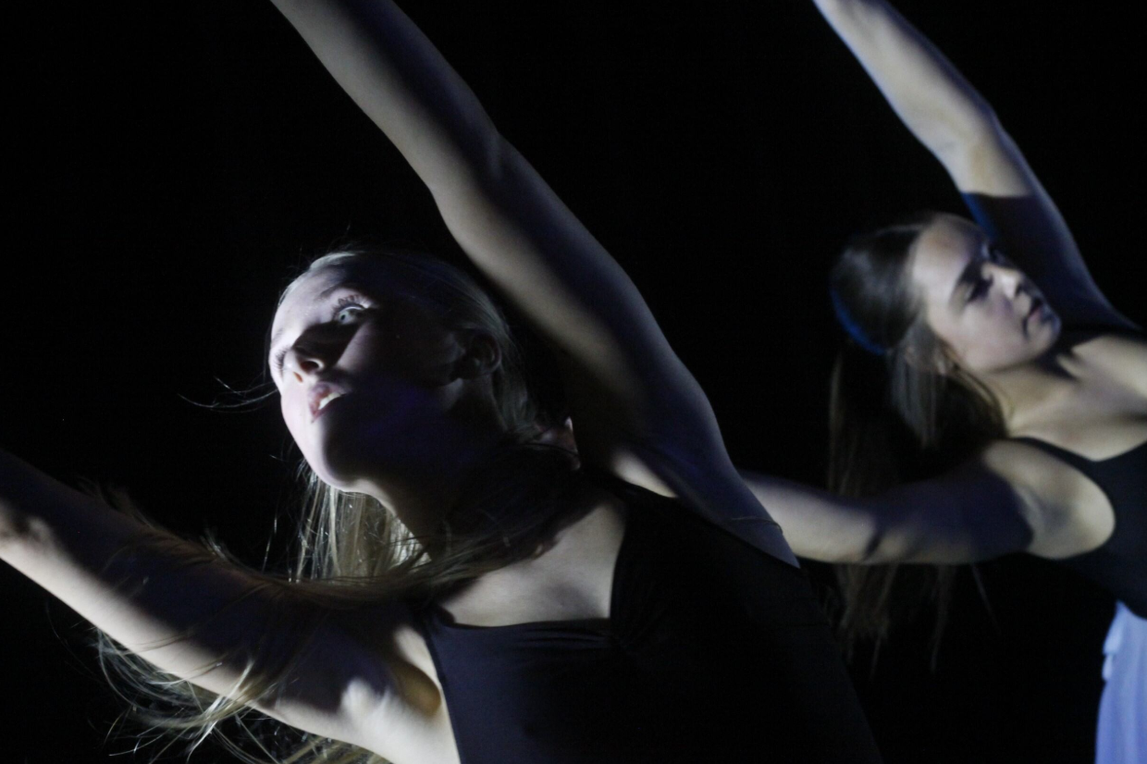
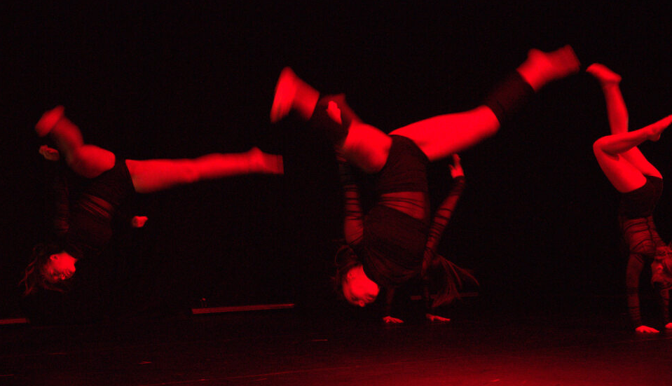
English Schools Cross Country Final
Our Junior Girls competed at the English Schools Cross Country Cup Final held in Yorkshire. The girls travelled all the way to Leeds to represent the College. This is the first time ECC have ever reached the national stage of this competition and the girls finished in 12th place (from 27 teams across England) which is incredible!
The girls should be super proud of their performance and will remember this experience for a very long time!! Well done Harriet P, Molly P, Lily-Grace H, Tess B and Ivy D.
Exmouth Eco's
This January the Eco Group raised £147 for the RSPB and Devon Wildlife Trust thanks to student & staff donations from the bake sale. Both charities have acknowledged the brilliant donations with thank you letters. ​
The RSPB also sent a certificate, and the Devon Wildlife Trust sent guides for the students to use to identify rocky shore animals and donated wildflower seeds.
Students from the group recently visited Exmouth Town Council to meet with a number of Town Councillors. ​The group shared their achievements this year towards ecology and improvement of the planet and also what we hope to do in the future. In return the Councillors outlined their eco initiatives. ​We look forward to continuing to build our relationship with the town council. ​
Mental Health and Wellbeing Update
The College hosted its first primary school’s mental health ambassadors conference. Students from across our local primary schools came to share what they were doing in their schools to promote good mental health and wellbeing. The students presented in front of us all which was very brave and then took part in a range of activities that can aid our wellbeing such as exercise, making sensory bottles and worry dolls.
Thank you to Heads Up for organising and facilitating this wonderful event.
Wellbeing Ambassadors
Following the half term break, our NHS Mental Health Support Team trained a new group of mental health ambassadors to join our current cohort. 22 Students from across all year groups were trained learning; What is positive mental health? How they want to make a difference at Exmouth Community College? How to be good listeners. Once training is complete we will have a wonderful team of mental health ambassadors on site!
6th Formers Prepare Delicious Noodle Bowl
For the last ‘Cooking on a Budget’, 6th Form elective before half term, students were given the choice of what they would like to cook and they chose RAMEN!
Giving Wagamama's a run for their money, that made tasty and versatile bowls of umami flavoured soup noodles with fresh vegetables and protein. A low budget staple for students that can be elevated to something more nutritious with a few modifications.
This is a dish best eaten immediately after preparation, we all sat down and had a communal meal with our efforts.
The Blend – Dance Production
Over 85 students performed in The Blend this year, with pieces choreographed in lessons and also by the students themselves for their exams over the next two weeks. These dances covered a wide range of topics. We also saw a brilliant piece performed by the Key Stage 3 dance club this year! The range of music, dance styles and incredible physicality was a tribute to the talent and dedication of our students at ECC.

Slide 3
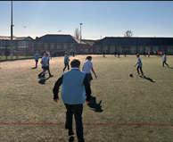

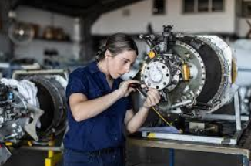
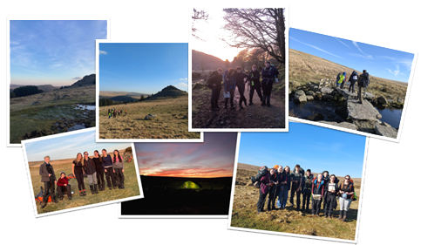
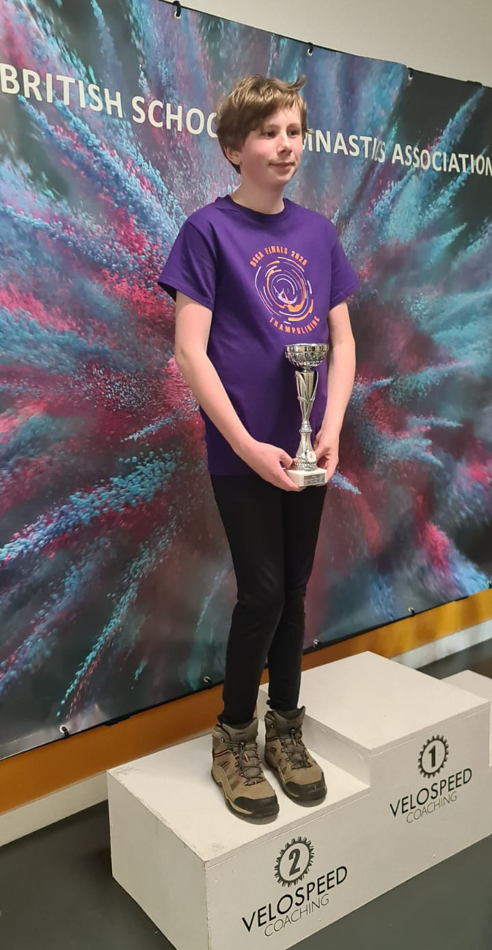
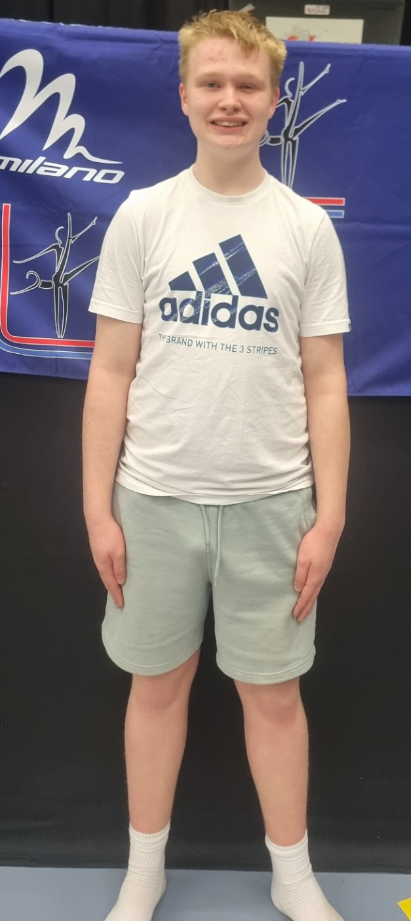
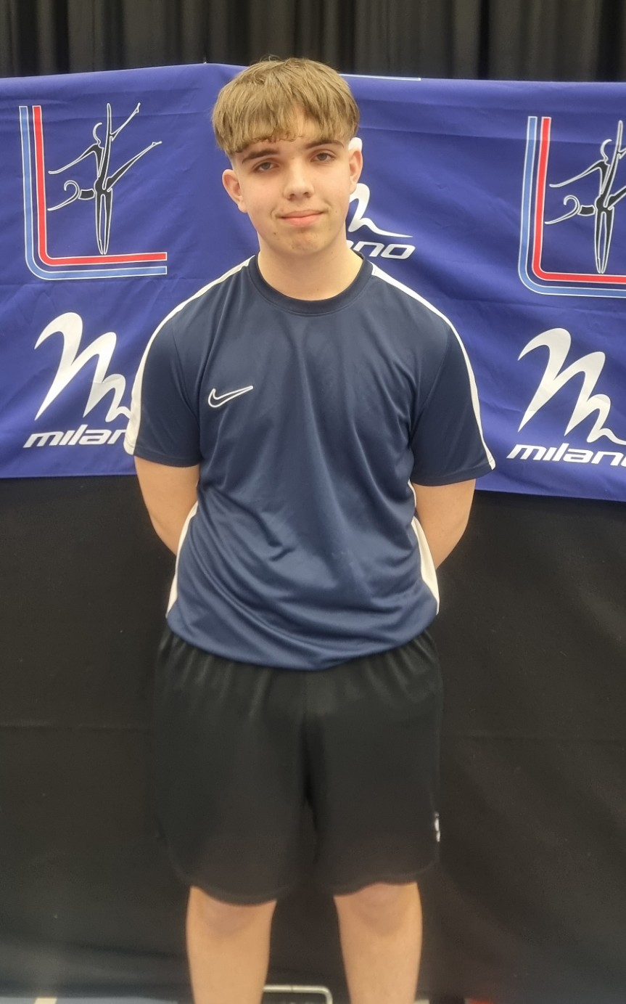
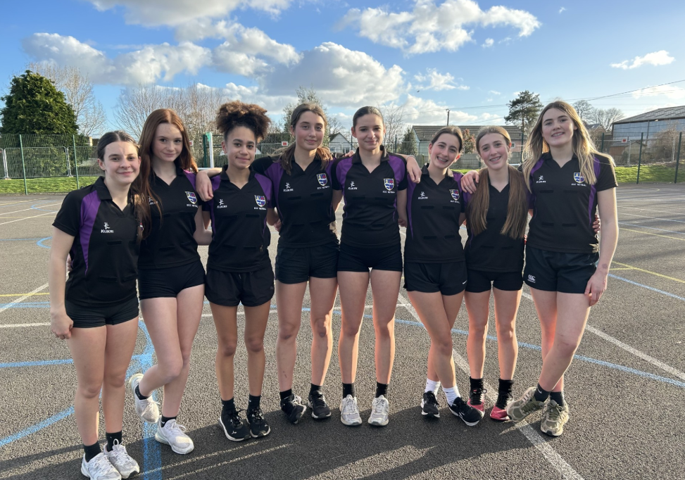
STUDENT NEWS
It’s been amazing to see how popular our House Football has been! The team spirit, boys and girls involved, encouragement and exciting football has been a pleasure to referee. Thank you to all the spectators who have come and supported. Please remember, fixtures are all on the College website in advance and our first league tables will be published in the middle of March! Mr Taylor
New Horizon’s
The weekly Sixth Form careers bulletin. An amazing resource containing lots of local and national opportunities that will shape their next steps.
Horizons Bulletin 24.2.25.docx
Apprenticeships and Events for School Leavers in Y11
For more information about the opportunities on offer see our newsletter here
Ten Tors Update
Training took place on south Dartmoor for the 45 and 35 team hopefuls in glorious sunshine. Both teams started in Holne and made their way to their wild camp spot via Princetown, walking in excess of 17 miles on the first day. They were rewarded with the most amazing sunset and clear skies overnight, but which also brought with it zero temperatures, waking to frosty tents and frozen bogs!
Their second day included a further 10 plus miles walk, finishing at Shipley Bridge near Ivybridge. Their endurance, navigation and resilience is a real credit to them all.
SPORTS UPDATE
Trampolining
Three of our amazing students competed nationally for Trampolining last week. George N placed 2nd in his category. Leon C placed 5th in his category and Tyler H placed 6th in his category. Coach Niki said “The students represented themselves and the school in great fashion as always. They all were fantastic. Thank you very much for supporting their journey this season. It has given these students an abundance of confidence, and a passion for the sport”
Netball
Some great results from the netballers recently.
U15 Team came 4th in the East Devon Tournament.
The U13's are absolutely smashing the U13 league so far and beat Colyton 19-9 recently.
The year 7's took part in a Ted Wragg Tournament on Monday 11th March, they won 6 games, drew won and finished as winners of the tournament.

Slide 4







General Information
Progress Evening Dates
A reminder that Progress Evening dates can also be found on our website here
Reporting Absence
Please report absence by emailing your child's Key Stage Attendance Team:
Key Stage 3 (Yrs. 7, 8 and 9) - ks3attendance@exmouthcollege.devon.sch.uk
Key Stage 4 (Yrs. 10 and 11) - ks4attendance@exmouthcollege.devon.sch.uk
Sixth Form (Yrs. 12 and 13) - ks5attendance@exmouthcollege.devon.sch.uk
Please include your child's full name, tutor group and the concise reason for absence.
Enrichment
Our enrichment timetable is available to download from our website, visit Student Enrichment and Leadership for up to date information on all the clubs and activities available for students.
Vacancies in College
We have a number of new vacancies advertised on our website here
Not seen a job for you?
Use our Talent Pool form to join our mailing list should appropriate career opportunities arise
Keep up to date
For daily information please visit the Student Bulletin or follow us on our social media
W/C 31st March – End of Term HOUSE Celebrations
Individual HOUSE Celebration assemblies throughout the last week of term.
4th April – Last day of Term
Will HOUSES raise enough for it to be a Mufti day?!
Donations still open via cash in the HOUSE buckets or online on iPay.

