Slide 1



Covid -19
Lateral Flow
Home Testing

Slide 2

Why
Consent
How to perform the test
How to record your results

Slide 3

From this week you will start performing your Covid-19 Lateral Flow tests at home
Why?

Slide 4

Up to 1 in 3 people who have Covid-19 have no symptoms and could be spreading it without knowing.
To help keep your friends and family safe
To help us return to normal life as quickly as possible

Slide 5

Do I have to do it?
Like the lateral flow tests you have been doing in college, no one is forced to do them.
BUT
We hope as many students and staff as possible will do them to try a reduce the spread of Covid-19

Slide 6
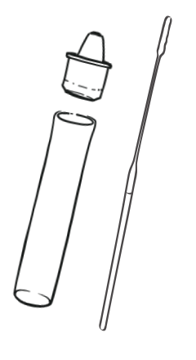
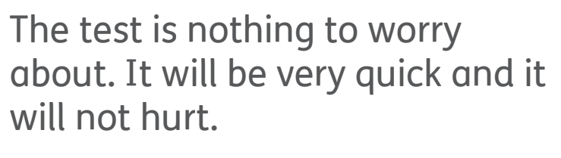
Let’s get started…

Slide 7
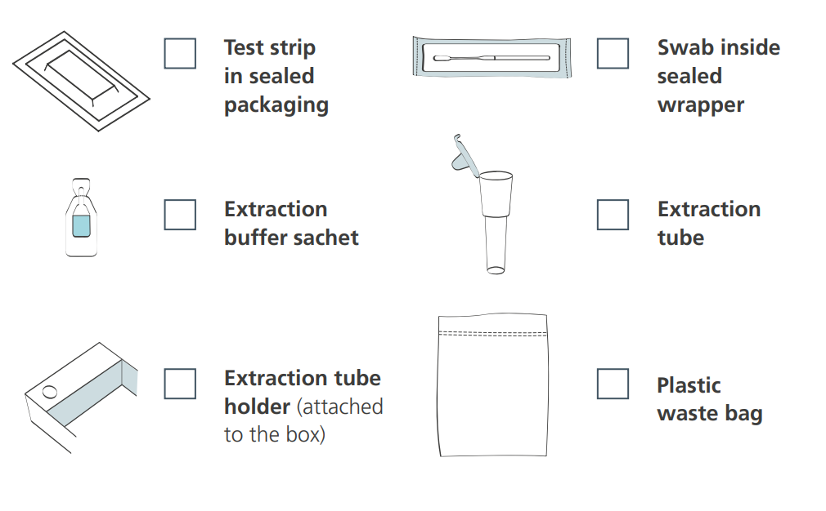
What’s in the box?

Slide 8
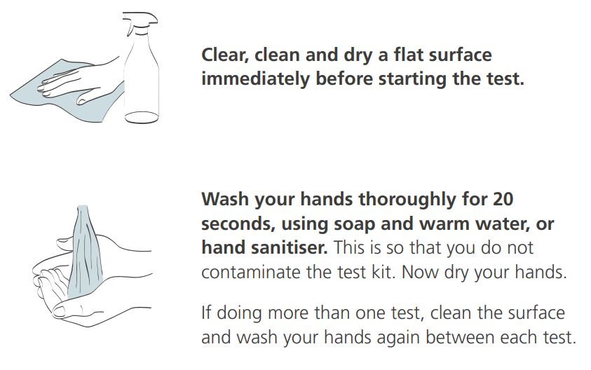
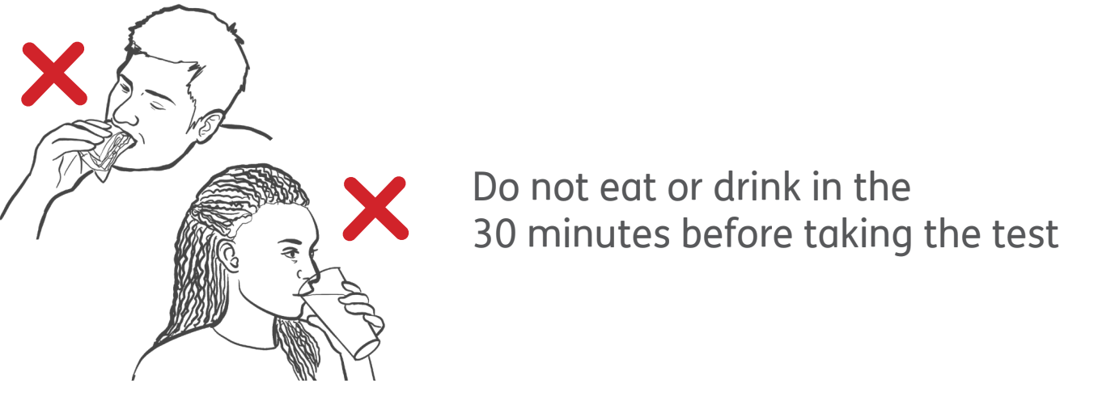
First of all…

Slide 9
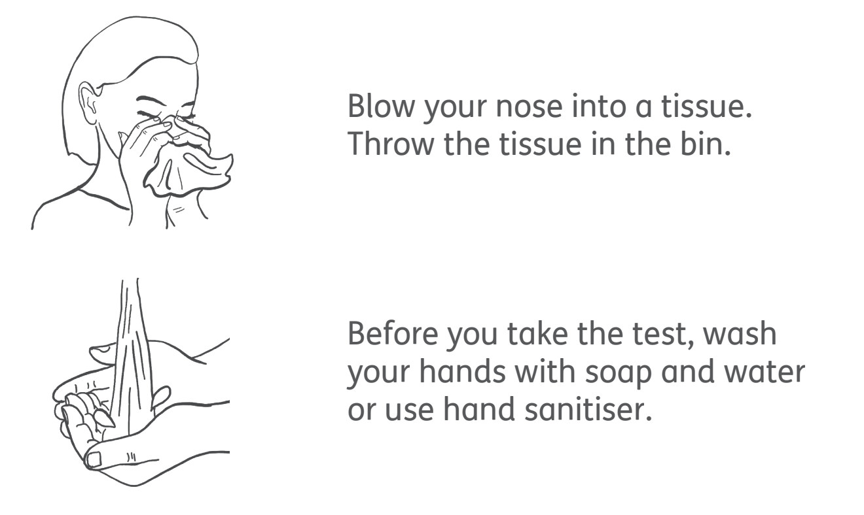
Then…

Slide 10
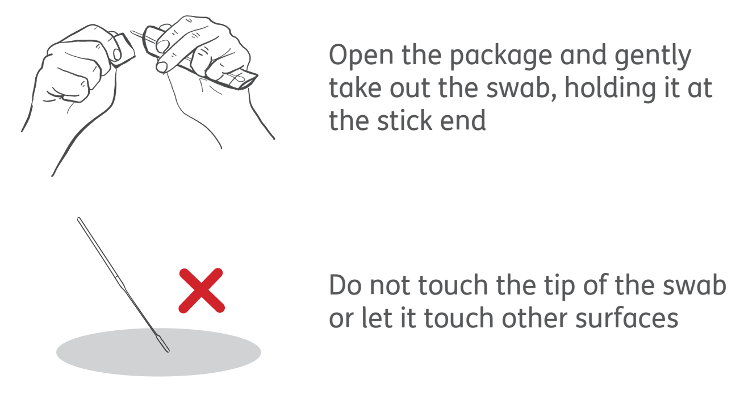
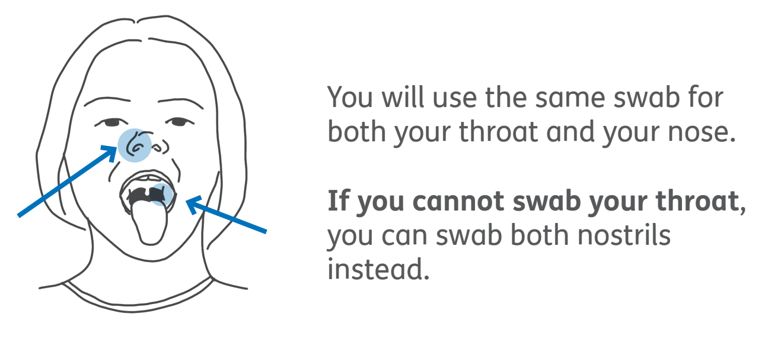
Remember…

Slide 11
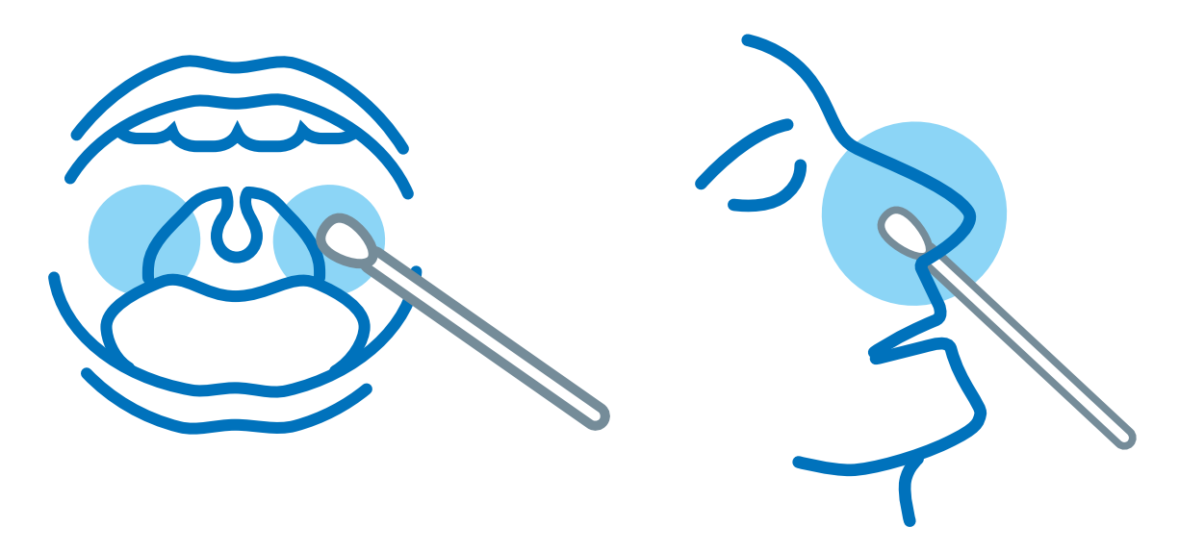
Swab…
10 x circles in the nostril
4 x each side of the back of your throat
Use the same swab for both your throat and nostril

Slide 12
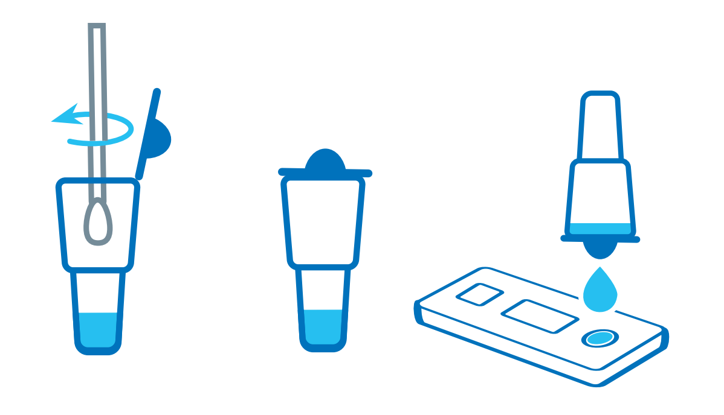
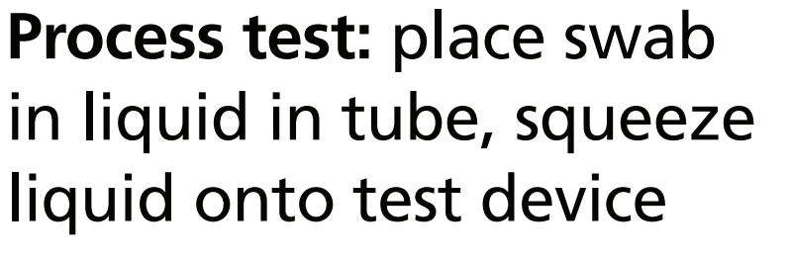
Process

Slide 13
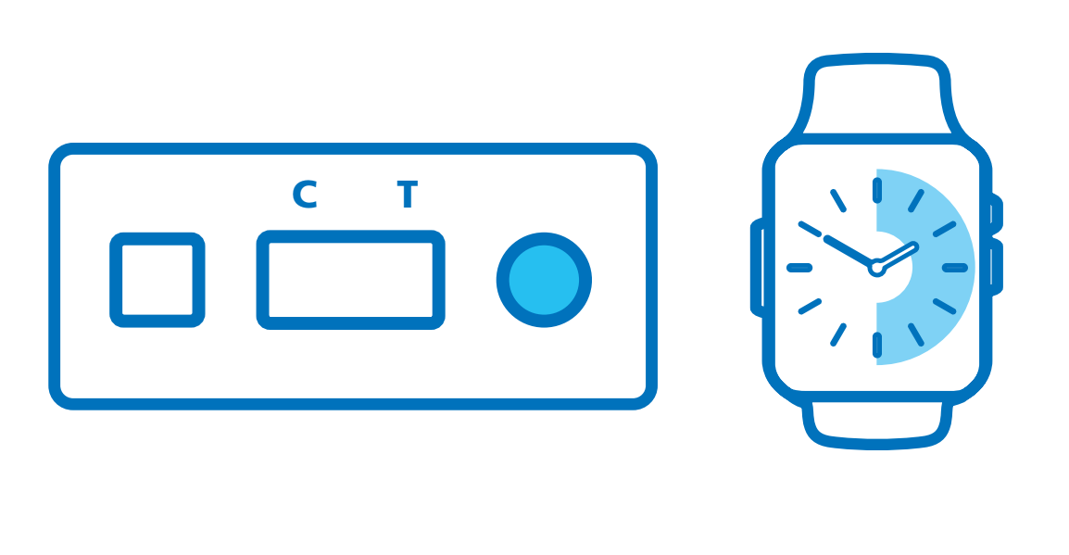

Result…

Slide 14

You need to report your result to both the college and on the Government website
Report…
Government website test reporting
Exmouth Community College - Student Home Lateral Flow Testing Results (exmouthcollege.devon.sch.uk)

Slide 15
Positive?
If your PCR test is negative you can return to college.
Report your result to the NHS Test and Trace Website
Report your result on the college website
Email positivecovidcase@exmouthcollege.devon.sch.uk
Self Isolate (including all your family/support bubble)
Book a PCR test on the Government website

Slide 16

Need some more help?
Please watch this short film which demonstrates how to perform the LFD test should you need anymore help

