Slide 1

A whole school reading initiative at ECC
How AR will impact on your reading age and your progress across the curriculum
(and answers to any other questions you may have! ☺)

Slide 2
How it works
AR will be undertaken by all KS3 and Year 10 students
Your STAR test generates your reading age and your reading range (ZPD) for the term
ALL students (year 7 – 10) will be expected to read their AR reading book for an average of 20 minutes a day
Many of your other lessons will begin with at least 5 minutes AR reading in order to support you and tutor time will incorporate AR reading as standard

Slide 3
Why is it so important?
There is a clear and proven link between students’ reading ages and their subject outcomes.
A local secondary school had a look at the average reading ages of their GCSE students. Students with higher reading ages did better across the board. Have a look!

Slide 4
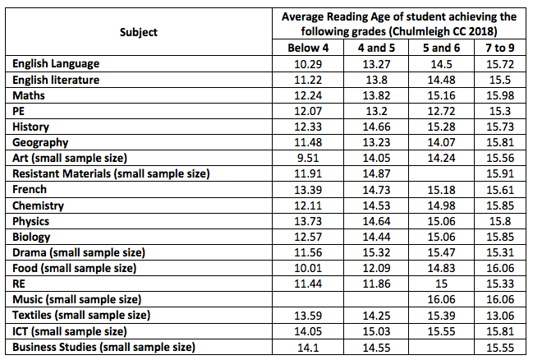

Slide 5
But it’s not all about exams!
There are so many other benefits from having positive reading habits!
Have a look…

Slide 6



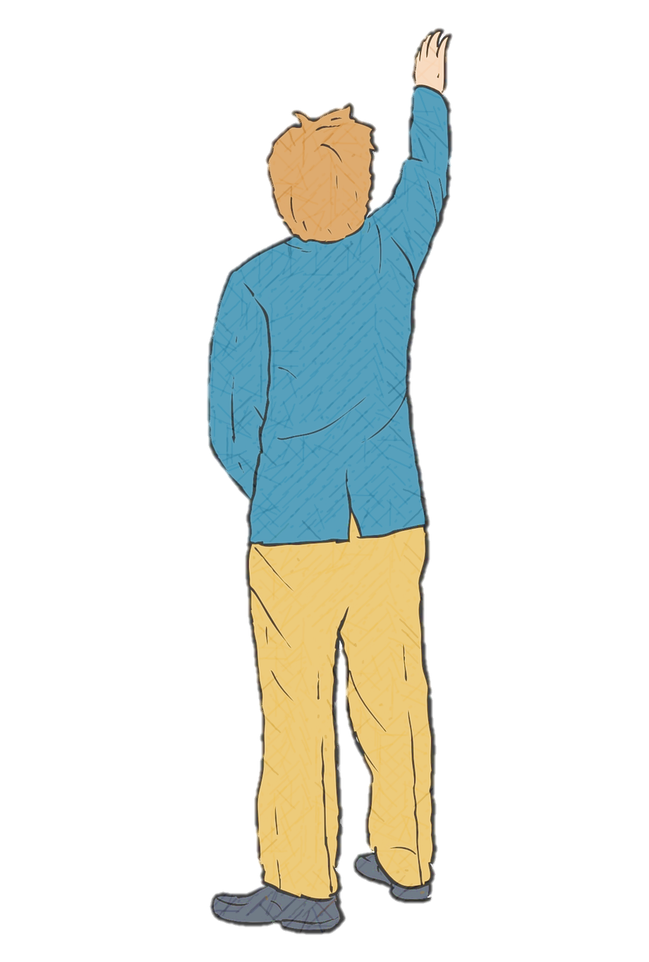


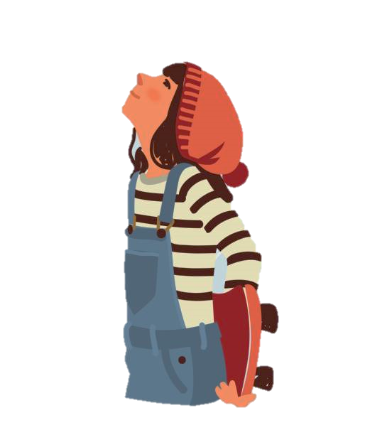
Potential

Slide 7




Accelerated Reader
Points for Prizes
The more books you read,
the more quizzes you can take.
The more quizzes you pass,
the more points you collect.
The more points you have,
THE BETTER THE PRIZE!
6 / 15 Bookmark
10 / 30 Item of Stationery
20 / 100 ‘Skip the Lunch Queue’ Pass
50 / 200 A Mufti Day
80 / 350 Book Voucher
125 / 450 Day Out Adventure Ticket for first 10 students to reach points
A Million Words — Certificate, Class Chart points
First to 10 million words— Prize to be confirmed
SKIP THE LUNCH QUEUE
Prizes will be delivered to your English class.
Sponsored in part by

Slide 8
How is my reading monitored?
AR is very clever! It knows your
reading age and therefore it knows how
long it should take you to finish your book.
When you have taken a quiz on your book, it works out how many minutes a day you must have read for.
Every two weeks your teacher runs a report in class to check your daily reading time is at least 20 minutes.
Praise Points will be issued where students have gone above and beyond!

Slide 9
Examples
Jenny has a reading age of 13.4 and a ZPD of 4.7-6.9
She takes one week to read a book levelled 5.2
She gets 10/10
AR calculates this took Jenny an average of 22 minutes a day to read
Jenny is now encouraged to select a book 5.3 or above and she is advised of any prizes she can collect.
Sarah has a reading age of 15.2 and a ZPD of 5.9 - 12.9
She takes two weeks to read a book levelled 5.9
She gets 8/10
AR calculates this book took Sarah an average of 9 minutes a day to read.
Sarah is now invited to Reading Club the following day to make up some of the time.

Slide 10
How do I borrow books from the library?
It’s easy! Log into RM Unify and select the Eclipse library tile.
If you are in Year 7, log in with your 20Firstname.Surname. Your password is your birthday in eight figures (for example 13072009)
If you are in any other year, log in with your Firstname.Surname. Your password is your birthday in eight figures (for example 13072011)
Use the search engine to search up a book/author you would like to read! Or you can search by genre if you would rather have a browse.
Don’t forget to check the book is in your level (see bottom left of screen!)
You will also be able to see if the book is in stock and if you can reserve it.
If you are having trouble getting online, your English teacher or tutor can give you a click and collect form to fill in. They will drop this in to the library for you.

Slide 11
When can I collect my book?
You may collect your book before school, at break/lunch or after school on your designated day. Duty staff will allow you to leave your collection point in ones or twos (no more!) to do this. Remember masks must be worn in the library:
Mon | 7
Tues | 8
Wed | 9
Thurs | 10
Fri | 11 & P16

Slide 12
How do I return my book?
Pop it in to the Turner block
collection box at the bottom of the stairs!
You can do this on any day.

Slide 13
How do I take a quiz?
Again- easy!
Log on and go to RM Unify
Go to Accelerated Reader
Choose ‘Take a Quiz’
Search up your book and away you go!
DO: Quiz as soon as you have finished your book!
DON’T: quiz on a book you haven’t finished, read a long time ago or have only seen the film of. It won’t go well.

Slide 14
What if I don’t take part?
It’s a whole school expectation and is not optional!
Do make sure you have find a book that is in your level and is enjoyable to you- then you will fly a long and enjoy your reading. If you are reading a particularly long book and have not quizzed in the last two weeks, your teacher may accept an email from a parent to confirm you have done your 20 minutes a day: please check with your teacher first, as this should not be a regular occurrence.
However, if your minutes still fall below the expected 20 when your teacher checks, you will be required to attend lunchtime reading club with and English teacher who will help you catch up.
Reading Clubs will commence fom the week beginning November 16th.

Slide 15

A whole school reading initiative at ECC

