Slide 1









Understanding
Coronavirus
0300 123 3393
www.youngminds.org.uk
Learning Objectives:
Call: 0808 801 0711
To understand the risks and symptoms of COVID-19 along with the precautionary NHS advice
To consider the implications of using coronavirus, or any illness, as a joke or insult
@NHSuk

Slide 2
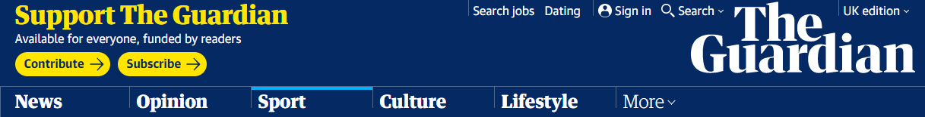

Read
Starter:
Learning Objective:
To consider the implications of using coronavirus, or any illness, as a joke or insult
0300 123 3393
Alli posted a video on Snapchat in relation to the virus while also singling out an Asian man in an airport. The FA wrote to him seeking his observations and has now decided to charge him with misconduct.
The offending video was uploaded by Alli to Snapchat earlier this month. It showed him wearing a face mask in an airport departure lounge and had the title: “Corona whattt, please listen with volume.” The video then cut to an unsuspecting man of Asian appearance before panning to a bottle of antiseptic hand wash, underneath which appeared the caption: “This virus gunna have to be quicker than that to catch me.”
Alli deleted the video and posted an apology to the Chinese social media network Weibo. “I let myself down and the club. I don’t want you to have that impression of me because it wasn’t funny … It isn’t something that should be joked about. I’m sending all my love and all my thoughts and prayers to everyone in China.”
www.youngminds.org.uk
Tottenham's Dele Alli charged by FA over coronavirus video on social media
England midfielder has until next week to answer charges
Alli posted video on Snapchat mocking Asian man
Tottenham midfielder Dele Alli has been charged with misconduct over his social media post regarding the coronavirus outbreak, the Football Association has announced.
Call: 0808 801 0711
Why do you think the Football Association have taken this Snapchat video so seriously?
How do you think the Chinese fan would have felt?

Slide 3
Covid-19
Learning Objective:
To understand the risks and symptoms of COVID-19 along with the precautionary NHS advice
0300 123 3393
What's the risk of coronavirus in the UK?
The UK Chief Medical Officers have raised the risk to the public from low to moderate.
Health professionals are working to contact anyone who has been in close contact with people who have coronavirus.
www.youngminds.org.uk
Symptoms of coronavirus
The symptoms of coronavirus are:
  a cough
  a high temperature
  shortness of breath
But these symptoms do not necessarily mean you have the illness.
The symptoms are similar to other illnesses that are much more common, such as cold and flu.
Call: 0808 801 0711
Source:
https://www.nhs.uk/conditions/coronavirus-covid-19/
@NHSuk

Slide 4
Covid-19
Learning Objective:
To understand the risks and symptoms of COVID-19 along with the precautionary NHS advice
0300 123 3393
How coronavirus is spread
Because it's a new illness, we do not know exactly how coronavirus spreads from person to person.
Similar viruses are spread in cough droplets.
It's very unlikely it can be spread through things like packages or food.
www.youngminds.org.uk
Call: 0808 801 0711
Do I need to avoid public places?
Most people can continue to go to work, school and other public places.
You only need to stay away from public places (self-isolate) if advised to by the 111 online coronavirus service or a medical professional.
Source:
https://www.nhs.uk/conditions/coronavirus-covid-19/
@NHSuk

Slide 5
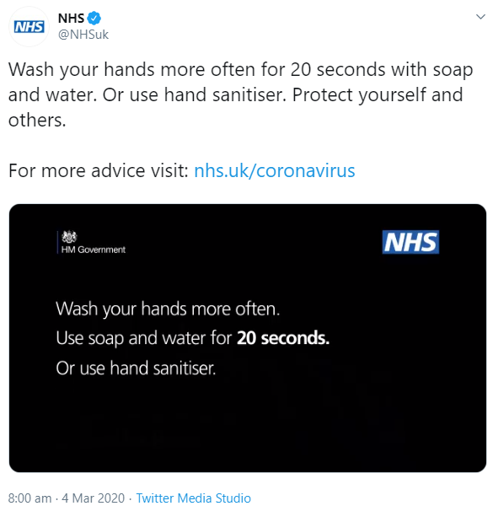
Advice
Learning Objective:
To understand the risks and symptoms of COVID-19 along with the precautionary NHS advice
0300 123 3393
www.youngminds.org.uk
Call: 0808 801 0711
@NHSuk

Slide 6
Advice
Learning Objective:
To understand the risks and symptoms of COVID-19 along with the precautionary NHS advice
0300 123 3393
Who knew that the best prevention strategy for coronavirus was
80s music?
www.youngminds.org.uk
No. Really.
Good hand hygiene is the key to limiting the spread of coronavirus, so washing your hands thoroughly is the way forward
According to the NHS ‘Thoroughly’ should mean about 20 seconds... The length of some of the 80s most iconic choruses!
So have a sing/hum along to these bangers while washing your hands…
Call: 0808 801 0711
@NHSuk

Slide 7


Learning Objective:
To understand the risks and symptoms of COVID-19 along with the precautionary NHS advice
0300 123 3393
www.youngminds.org.uk
Call: 0808 801 0711
https://www.youtube.com/watch?v=djV11Xbc914
Take on me (Take on me)
Take me on (Take on me)
I'll be gone
In a day or two
@NHSuk

Slide 8

Learning Objective:
To understand the risks and symptoms of COVID-19 along with the precautionary NHS advice
0300 123 3393
www.youngminds.org.uk
Call: 0808 801 0711
https://www.youtube.com/watch?v=JmcA9LIIXWw
Karma, karma, karma, karma, karma chameleon
You come and go, you come and go
Loving would be easy if your colors were like my dreams
Red, gold, and green, red, gold, and green
@NHSuk

Slide 9

Learning Objective:
To understand the risks and symptoms of COVID-19 along with the precautionary NHS advice
0300 123 3393
www.youngminds.org.uk
Call: 0808 801 0711
https://www.youtube.com/watch?v=FTQbiNvZqaY
It's gonna take a lot to drag me away from you
There's nothing that a hundred men or more could ever do
I bless the rains down in Africa
Gonna take some time to do the things we never had
@NHSuk

Slide 10
Check
0300 123 3393
www.youngminds.org.uk
Learning Objectives:
To understand the risks and symptoms of COVID-19 along with the precautionary NHS advice
To consider the implications of using coronavirus, or any illness, as a joke or insult

Call: 0808 801 0711

@NHSuk

