Slide 1


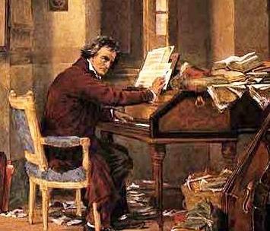






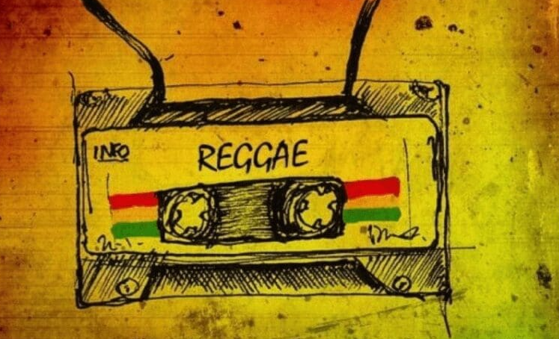
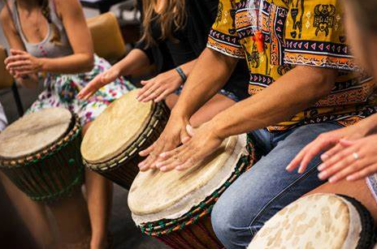
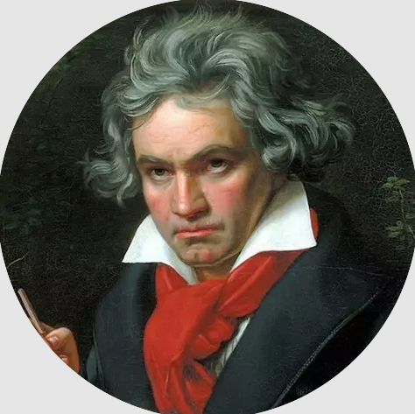

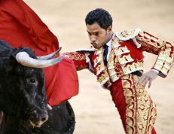
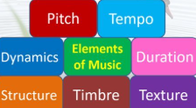
The
Music Learning Journey at ECC
Yr 11 Term 3: Set works revision
Yr 11 Term 2: Revision and exam practice
Yr 10 Term 3: Rhythms of the world, conventions of pop
Yr 11 Term 1: Film Music, Concerto through time
Year
11
Yr 10 Term 2: Music Theory, keys, scales and chords, composing
Yr 10 Term 1: Performing, developing ensemble skills, set works
Yr 9 Term 2: Film music, foley sound, composing
Yr 9 Term 3: Music you should know, performing
Year
10
Year
Yr 9 Term 1: Development of Pop, class performance
9
Yr 8 Term 3: Reggae, composing
Yr 8 Term 2: Rhythms of the world
Year
8
Yr 7 Term 3: Performing, Beethoven
Yr 8 Term 1: HipHop arrangement
Year
7
Yr 7 Term 2: Orchestra, singing, improvisation, Carmen
Yr 7 Term 1: Notation, musical elements, Swan Lake

