Slide 1


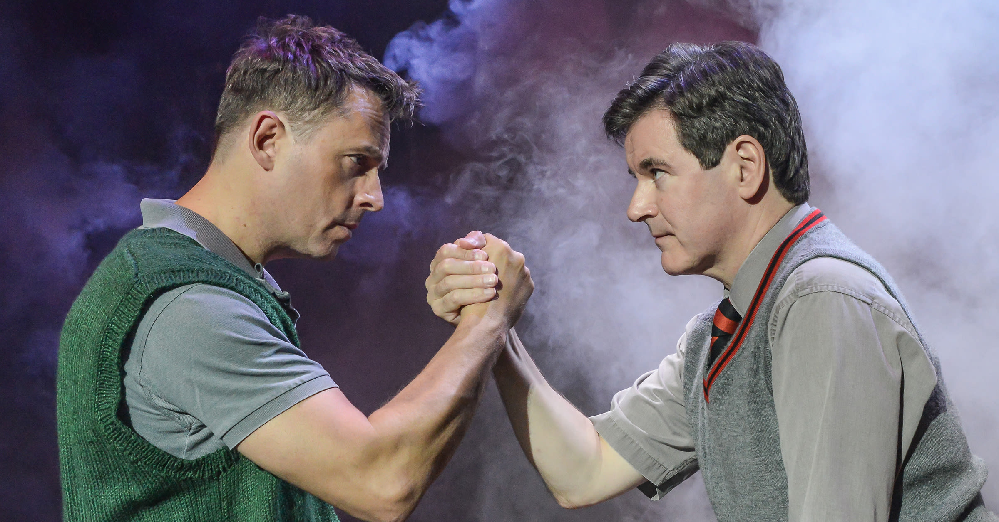
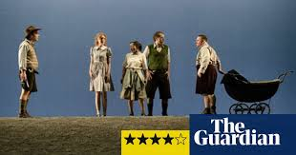



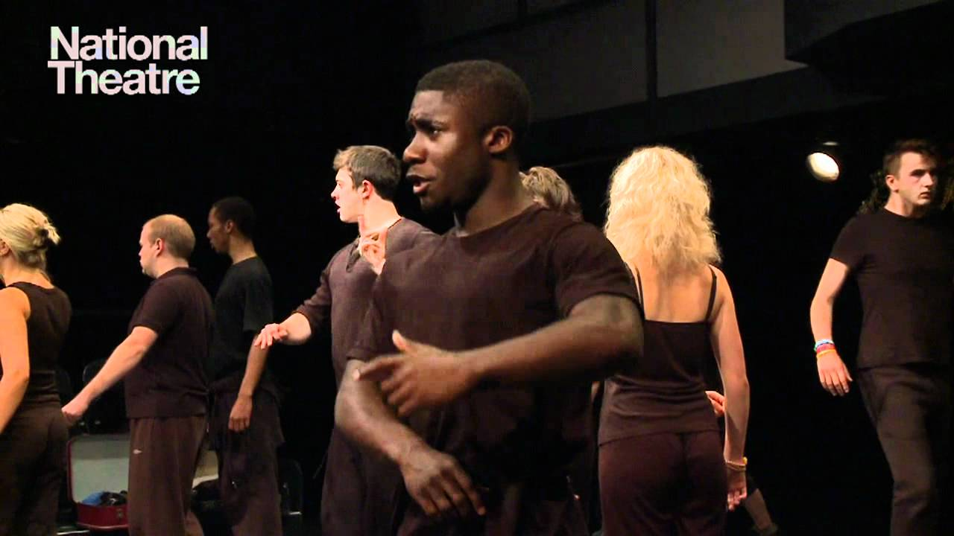
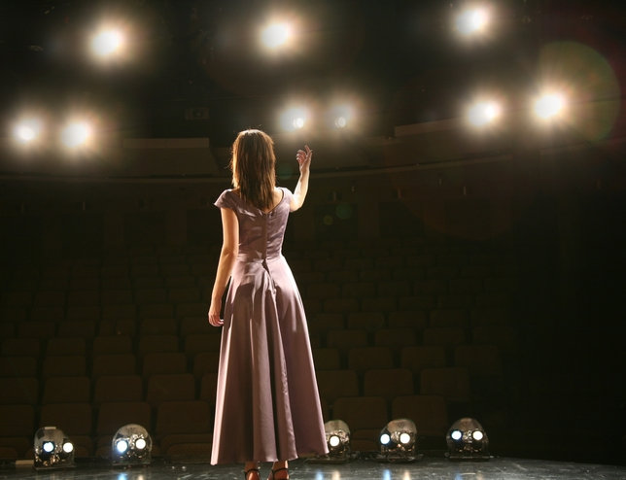
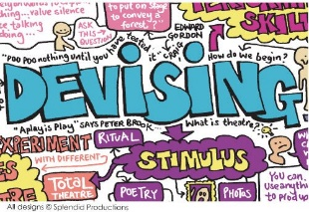
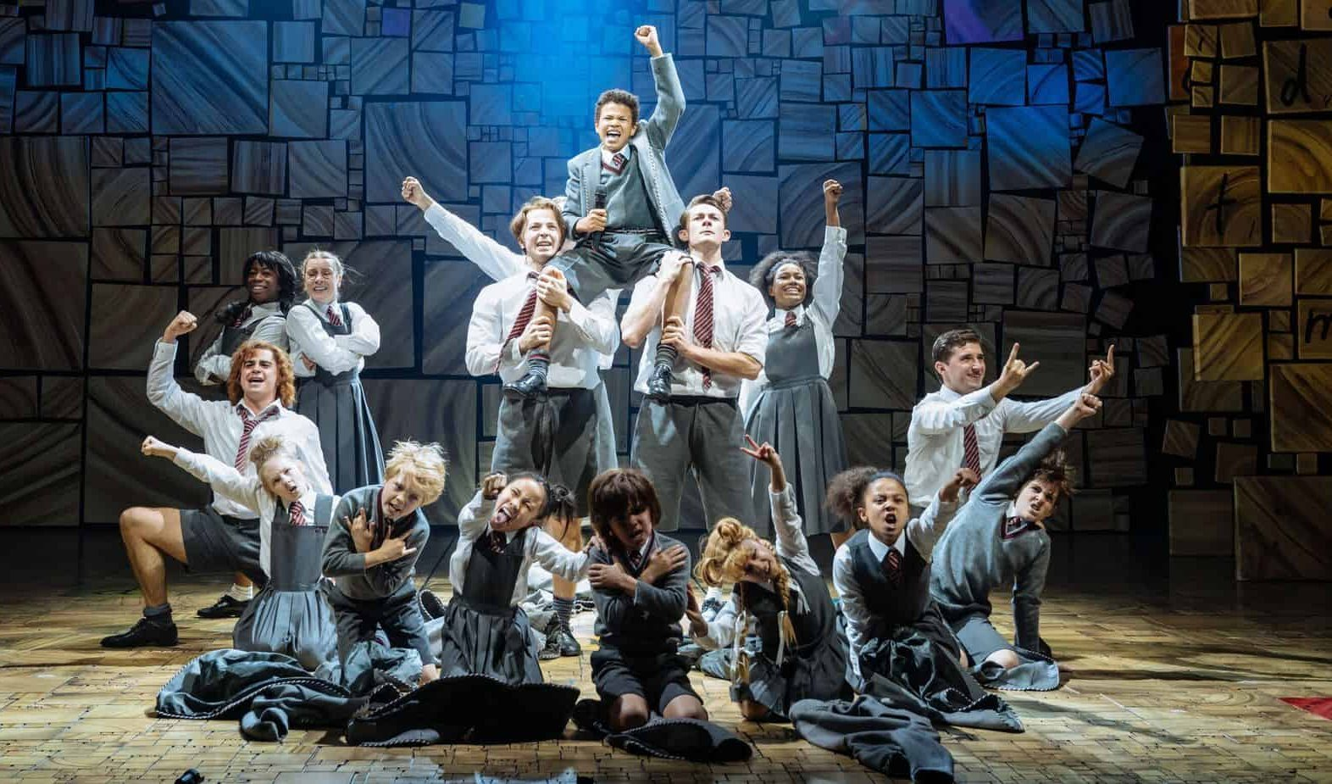
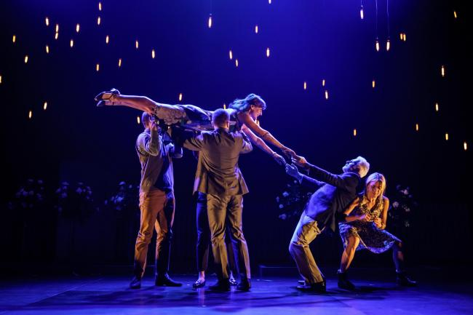

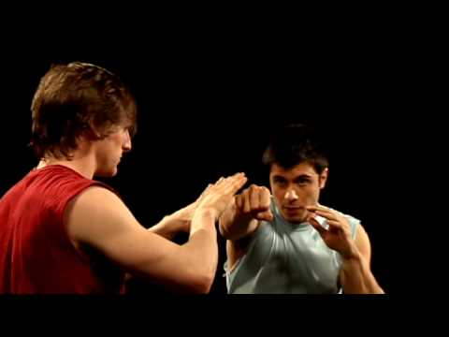

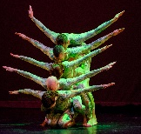

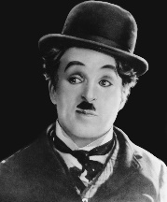
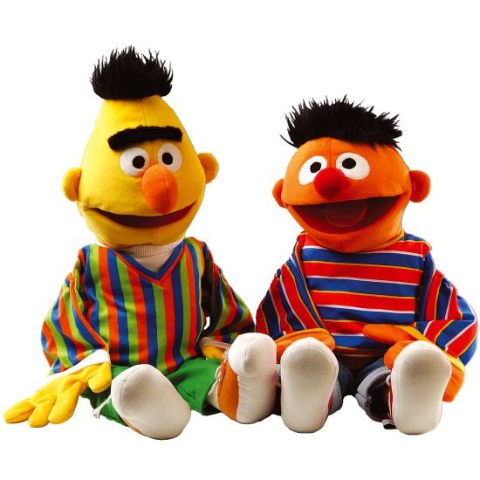
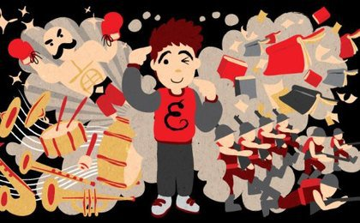
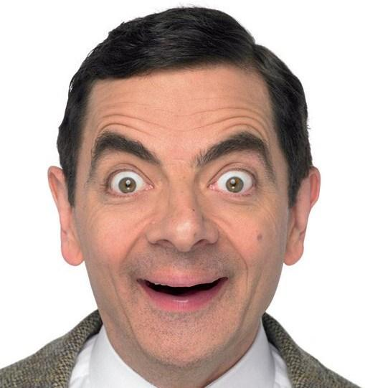


Core Values
Knowledge
Skills
Links
Drama Learning Journey
Progression to:
A Level Drama & Theatre
BTEC Performing Arts
Understanding
Drama
Texts in
Practice
Externally examined written paper covering theatre terminology, study of a set text and response to live performance work
Work in keeping with Playwright’s intentions
Links: Bugsy Malone, M&D, Group script
Understanding of theatre roles and subject specific terminology. Ability to articulate how meaning is created in performance.
Links: KS3 script and evaluative work, Style and Genre,
Characterisation
Contextual awareness
Status relationships
Externally examined script extracts
Analytical and evaluative written skill
11
Style &
Genre
Devising
Drama
Links: Devising/ Physical Theatre and Group Devising
Module summary: Greek/ Frantic and Commedia based devised work. Assessment: Performance and Devising Log
Understanding of a range of approaches to devising theatre
Working collaboratively on script interpretation and development
Devising
Verbatim
Multi-role
Physical theatre
Tableau
Links: Devising/ Physical Theatre and GCSE Comp 1&2
Stimulus development
Devising
Physical theatre
Development, refinement, performance, analysis and evaluation of skill in devising theatre from a stimulus.
Module summary: Stimulus based devising techniques. Assessment: Process record
Module summary: Exploration and development of whole class play. Assessment: Class performance
Characterisation
Contextual awareness
Status relationships
Module summary: Developing script extracts for audition. Assessment: Audition performances
Skills Audit
10
Group Devising
Links: Bugsy Malone, and GCSE Comp 1&3
Identifying contextual factors in script and using this to inform interpretation
Module summary: Exploration and development of Frantic Assembly Physical Theatre techniques. Assessment: Cinema Whole Group Physical Theatre performance
Physical sequencing
Group devising
Timing
Choreography Movement
Links: Clowning, Group Devised/ Physical Theatre and GCSE Comp 1&2
Group scripts
Links: Working from Script, Bugsy Malone, Group scripts & GCSE Comp 3
Module summary: Development of script extracts for performance. Assessment: Duologue performances
Links: Working from Script, Bugsy Malone, Group scripts and GCSE Comp 1&3
Characterisation
Contextual awareness
Status relationships
Identifying contextual factors in script and using this to inform interpretation
Characterisation
Contextual awareness
Status relationships
Learning and applying Frantic Assembly techniques
Module summary: Exploration of period and style. Assessment: Bugsy script extract.
9
Monologues and duologues
Stage Combat
Cinema
Intonation
Contextual awareness
Multi-role
Physical Theatre
Characterisation
Knowledge of a range of stage combat techniques and development of contextual scenarios
Module summary: Exploration and development of stage combat techniques. Assessment: Stage combat routine.
Stage combat
Positioning
Timing
Action and reaction
Vocal range
Movement control
Understanding of themes, characters, language and structure in Macbeth
Links: Clowning, Group Devised/ Physical Theatre and GCSE Comp 1,2&3
Module summary: Exploration of story, language and themes in the play. Assessment: Whole class edited production
1920’s New York and American gang culture during this period
Links: Working from Script, Monologues and Duologues, Group scripts and GCSE Comp 1&3
Bugsy Malone
Devising/ Physical Theatre
Macbeth
Characterisation
Contextual awareness
Accent
Blocking
Links: Working from Script, Monologues and Duologues, Group scripts and GCSE Comp 1&3
Knowledge of a range of techniques to use to aid in the creation of devised theatre. Focus on work of Off Balance theatre company
Physical Theatre
Storytelling
Sound-scaping
Multi-role
Cross-cutting
Module summary: Analysis and adaptation of work of Off Balance theatre company. Assessment: Restricted theatre retelling of a fairy-tale
Links: Fantasy, Group Devising and GCSE Comp 1&2
Links: Devising/ Physical Theatre, Group Devising and GCSE Comp 2
Creation and operation of different puppet types
Module summary: Creation of puppets and development of vocal character. Assessment: Puppet performance
Working from script
8
Silent
Movies
Vocal techniques
Storytelling
Puppeteering
Puppets
Links: Silent Movies, Cinema and GCSE Comp 2
Links: Macbeth, Bugsy Malone, Monologues and Duologues, Group scripts and GCSE Comp 1&3
Interpretation of character and dramatic intention through script
Characterisation
Script interpretation
Blocking
Audience awareness
Module summary: Exploration of a range of styles of script. Assessment: Ernie’s Incredible Illucinations
Slapstick
Mime
Physical Comedy
Timing
Stock Characters
Understanding of the Silent Movie Era and style. Exploration of key figures in the industry
Module summary: Exploration of key silent movie conventions. Assessment: Silent Movie scenarios
Parody
Mime
Physical Comedy
Exaggeration
Links: Clowning, Cinema and GCSE Comp 2
Melodrama
Spies and Secret Agents
7
Stock characters
Devising character and storyline
Fantasy
Module summary: Exploration of melodrama style – developing exaggerated physical skills with stock characters
Links: Devising/ Physical Theatre, Group Devising and GCSE Comp 2
Module summary: Creation of scenes and transitions of fantasy journey. Assessment: Secrets in the Attic
How to utilise different approaches and techniques to create new work
Devising Skills
Action/ Reaction
Mime
Freeze-frame
Module summary: Development of core vocal and physical skills needed to create a character. Assessment: James Pond Story
Skills audit
Foundation for all performance styles
Core skills built for all future modules in terms of performer expectations.
Characterisation
Blocking
Audience awareness

