Slide 1
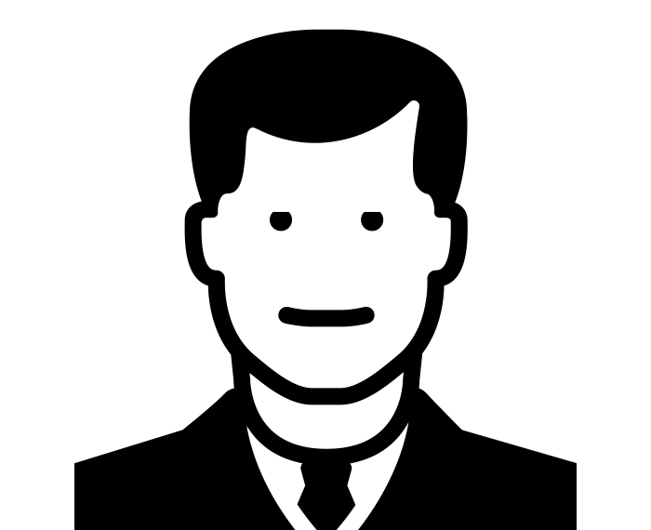


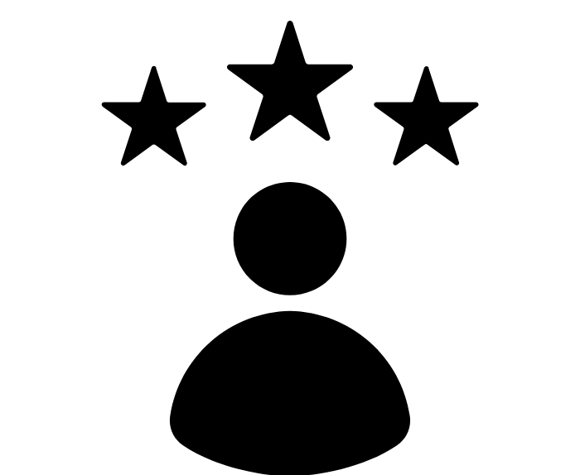
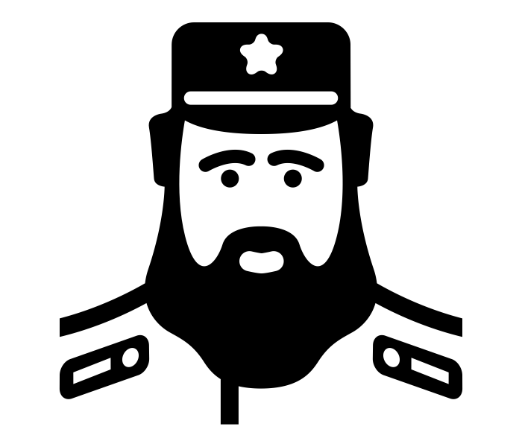
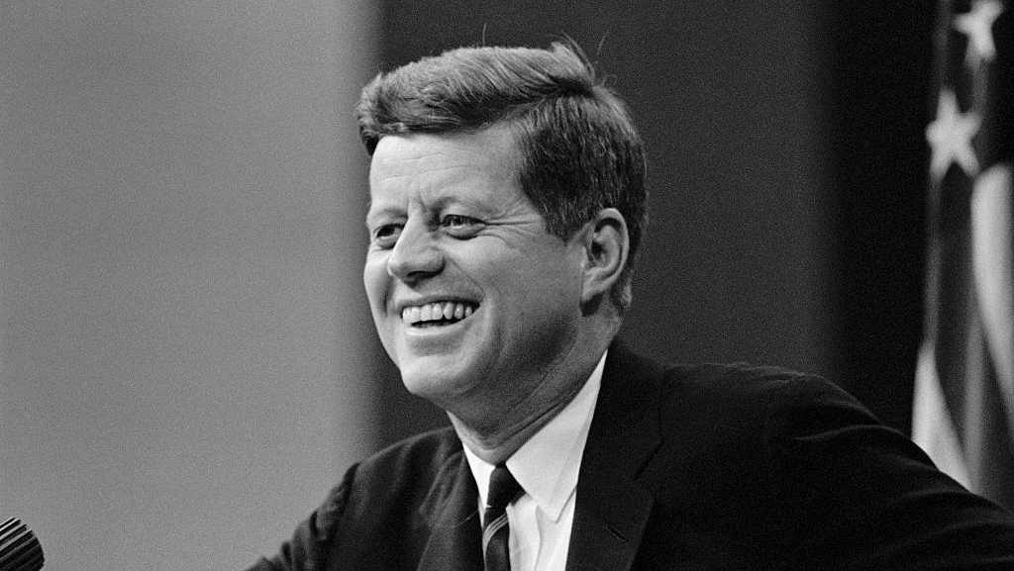

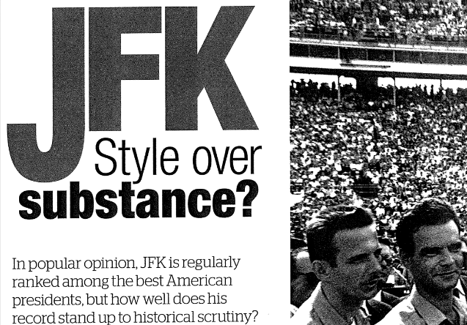
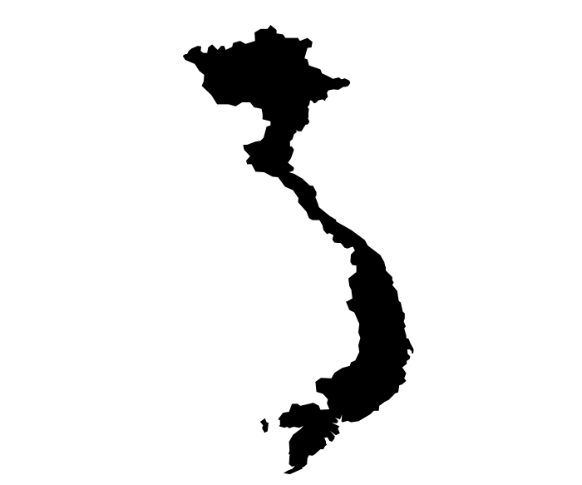
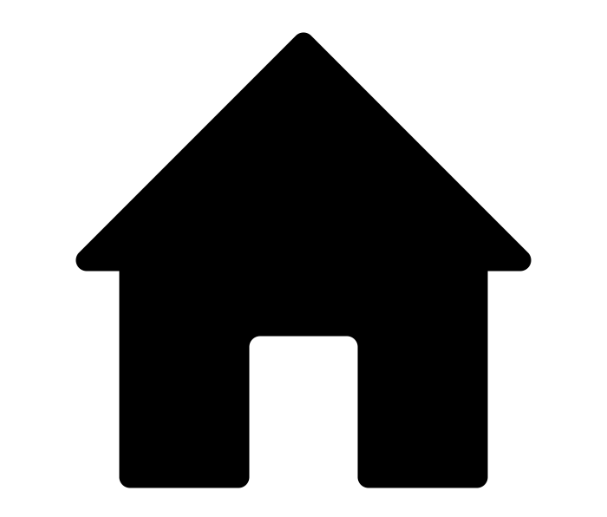

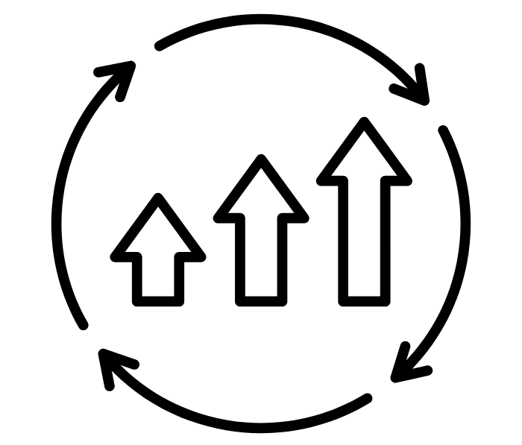
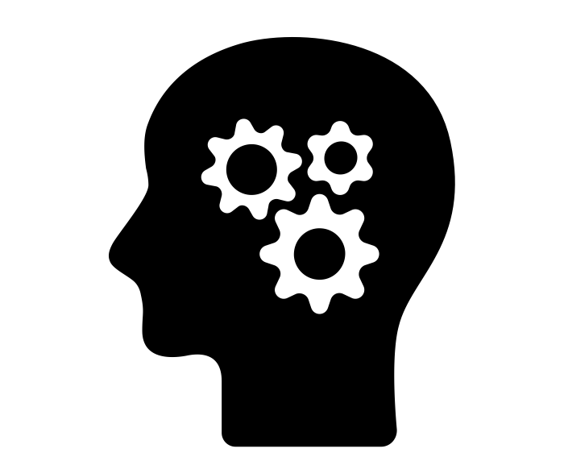
BBC History Magazine: JFK: Style over Substance November 2013
What action did Jackie Kennedy take immediately after her husband’s death?
________________________________________________________________________________________
TASK: Read the connected article on JFK by Mark White. It assesses historians interpretation of Kennedy and how these interpretations have been shaped.
Answer all 10 questions in as much detail as possible.
Don’t worry if you miss any, we will review our answers together as a class.
2. What was Kennedy compared to by Jackie?
______________________________________________________________________________________
3. What was Kennedy’s area of expertise?
___________________________________________
______________________________________________________________________________________
4. How have historians been critical of Kennedy’s actions towards Cuba?
______________________________________________________________________________________________________________________________
5. How successful was Kennedy during the Vienna Summit?
______________________________________________________________________________________
6. How did Kennedy deepen US commitment to Vietnam?
__________________________________________________________________________________________________________________
7. What were the three areas of domestic reform for Kennedy?
____________________________________________________________________________________
10. How had Kennedy matured as a President in 1963?
______________________________________________________________________________________________________________________________________________________________________________________________________________________________________________________________________________
8. How committed was Kennedy to Civil Rights?
______________________________
____________________________________________________________
9. How have historians viewed Kennedy’s moral character? ____________________________________________________________________________________

